Slide 1
Health care
Or Livne
Roey

Slide 2
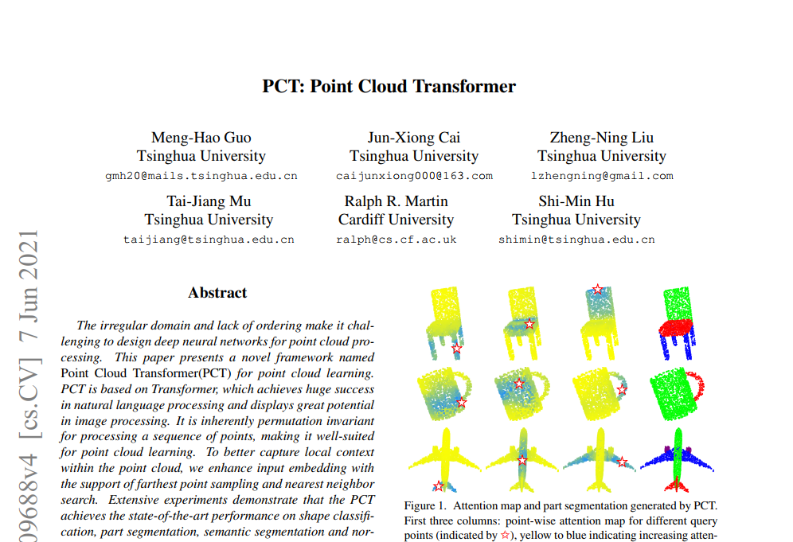
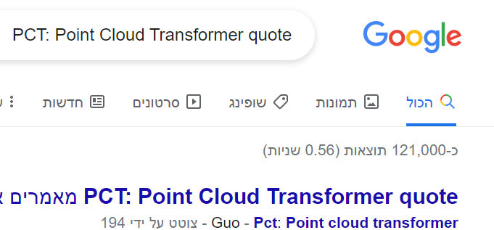
Paper name

Slide 3
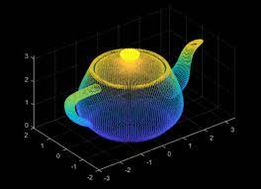
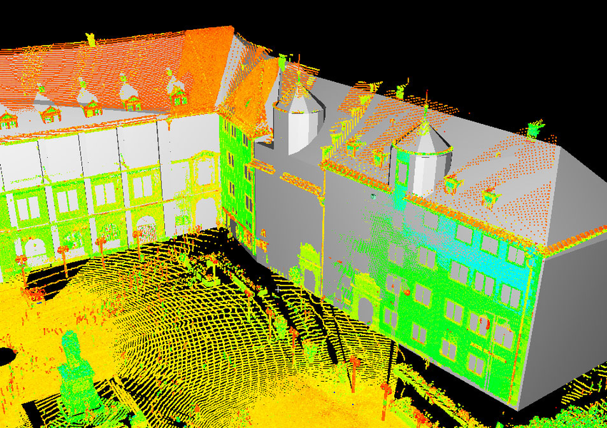
point CLOUD
What is points cloud is ?
How to create point cloud ?
How are they using in different applications ?

Slide 4
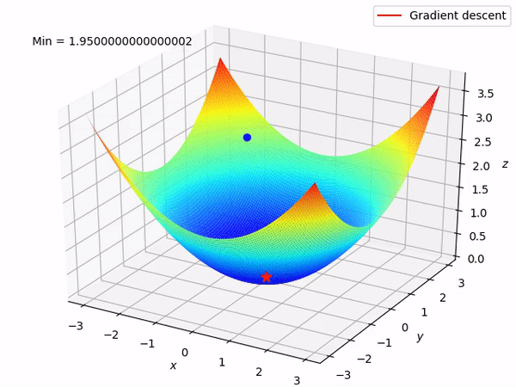
point CLOUD
What is points cloud is ?
Collection of individual 3D point which can be presented by:
Location: (X, Y, Z)
Additional information (Like color (R,G,B) values)
https://www.youtube.com/watch?v=IKfbiFQB_0U

Slide 5
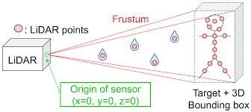
point CLOUD
How to create point cloud ?
Scan by using laser scanner
The laser sending a pulse into static object, by measuring the reflect reaction from the object by laser scanner we can represent each point exact location in 3D

Slide 6
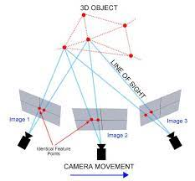
point CLOUD
How to create point cloud ?
Process name Photogrammetry
Creating point cloud by using multiple image of the same object, by triangulate process, the algorithm knows to generate the point cloud

Slide 7
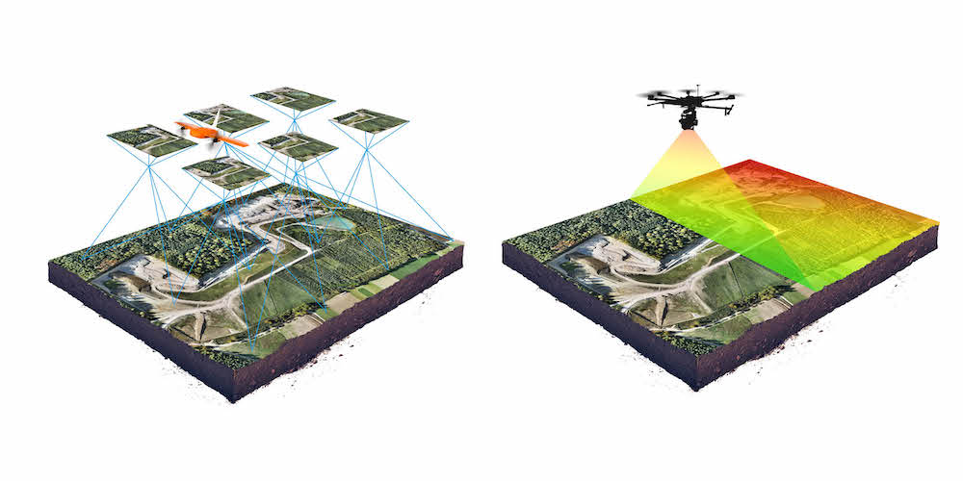
Photogrammetry vs. laser scanner
photogrammetry advantages:
High ability to reproduce an object in full color and texture, While not any 3D scanners can do this
easily accessible to most people because the equipment and software is nowhere near as expensive as 3D scanning.
photogrammetry disadvantages:
challenging to work with parts that have a smooth, flat …
real time as 3D scanning
lower accuracy than 3D scanners.

Slide 8
point CLOUD
Mashes:
Convert point cloud to Mesh is a technique for reconstructing a surface mesh from an input point cloud.
In order to move from point cloud in 3D, we move to mesh representation:
https://ranahanocka.github.io/point2mesh

Slide 9
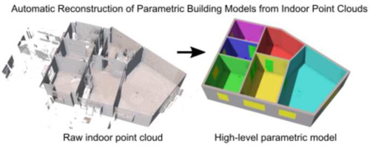
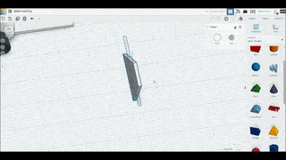
point CLOUD
How are they using in different applications ?
Create a 3D model - point cloud converted into meshes
Understanding environment – building, automotive
Manufacturing – design product

Slide 10
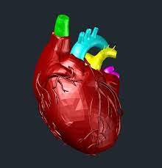
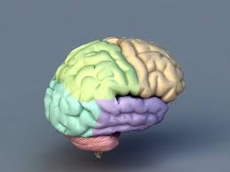
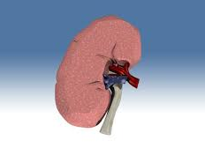
point CLOUD
How are they using in different applications ?
Create a 3D model - point cloud converted into meshes
Medical
Explain ability about different organ in our body
Examine decease
Simulation – for doctor's paretic: https://www.youtube.com/watch?v=2RkmGapgMbc

Slide 11
Paper flow
Transformer
for Point
Cloud Representation
Point-based deep learning
Vision transformers
NLP transformers

Slide 12
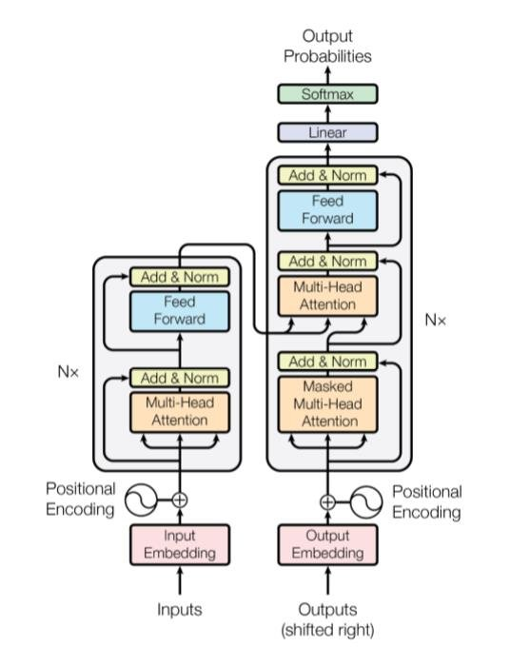
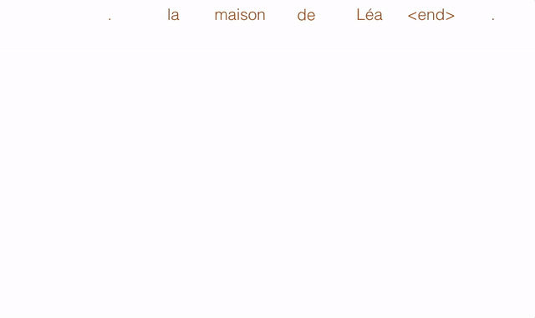
Paper flow
NLP transformers:
New family of natural network architectures from the paper “attention is all you need” (2017 )
the general idea is to add context to the prediction of architectures.
In NLP task needed to convert sentences into sequence of tokens which feed into the attention block.
The NLP transformers achieve state of the art performance on NLP tasks

Slide 13
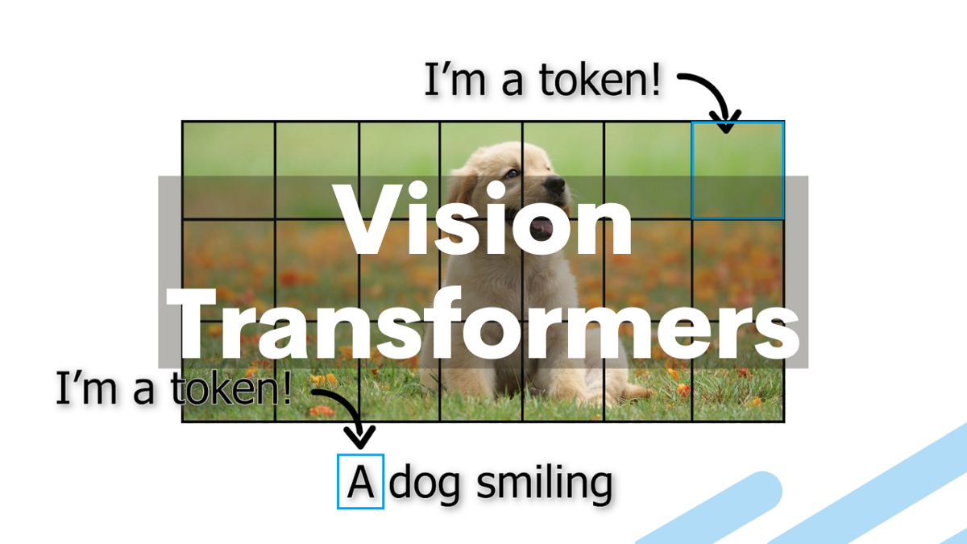
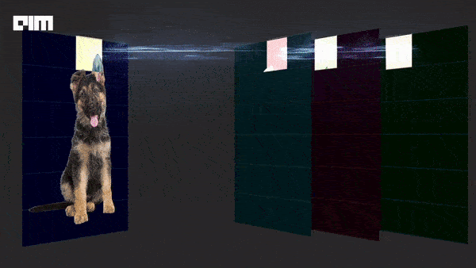
Paper flow
Vision transformers:
Inspired from NLP transformers, vision field, also apply self-attention concept
In order to use transformers, each image need pass tokenization:

Slide 14
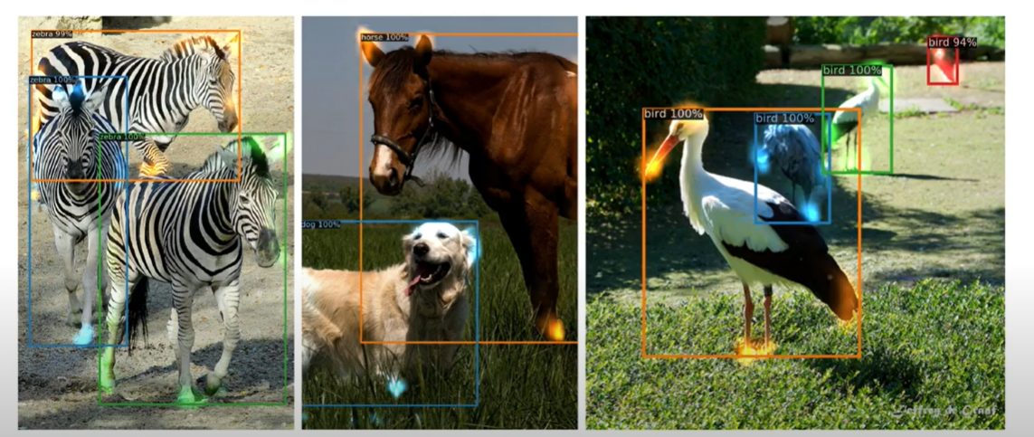
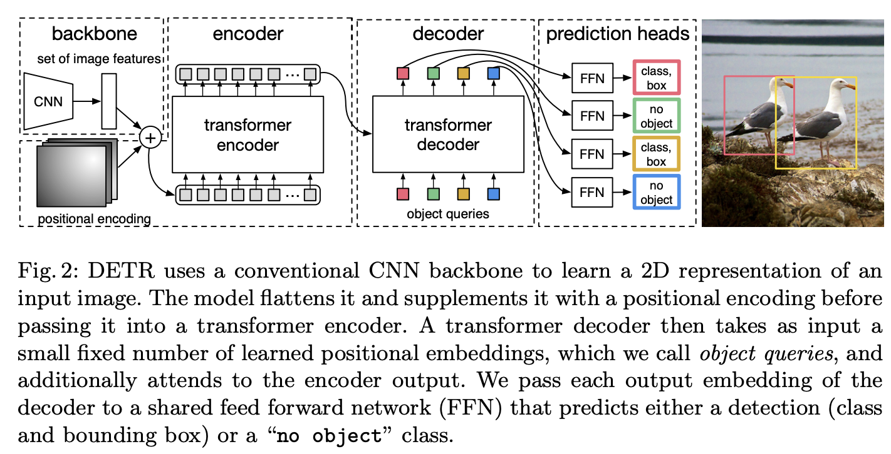
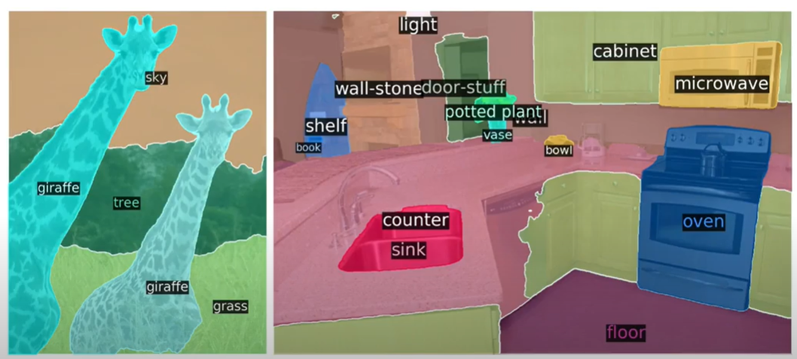
Paper flow
Vision transformers:
the main paper that achieve state of the art results was DETR (2020)

Slide 15
TIMELINE
Work that inspired the paper writers:
Point net(2017)
Point net ++(2017)
PCT(2021)
Point CNN(2018)

Slide 16
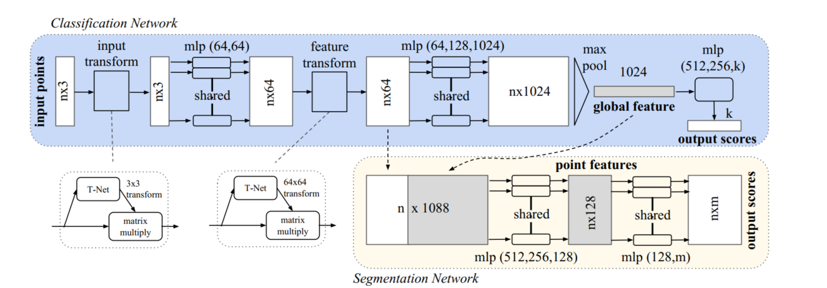
TIMELINE
Work that inspired the paper writers:
Point net(2017)
we propose a novel deep neural network PointNet that directly consumes point cloud.
approach for 3D recognition tasks including :
object classification
part segmentation
semantic segmentation

Slide 17
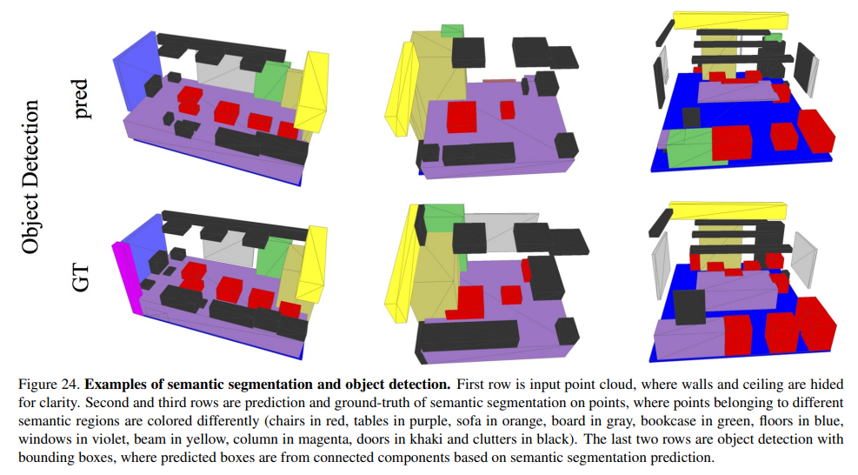
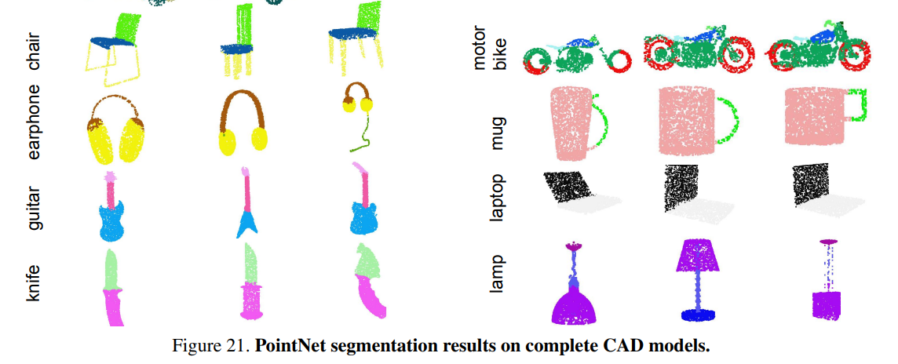
TIMELINE
Work that inspired the paper writers:
Point net(2017)
examples

Slide 18
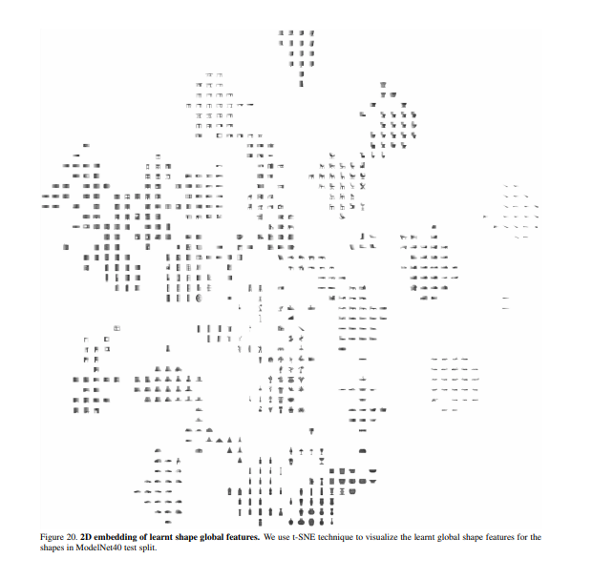
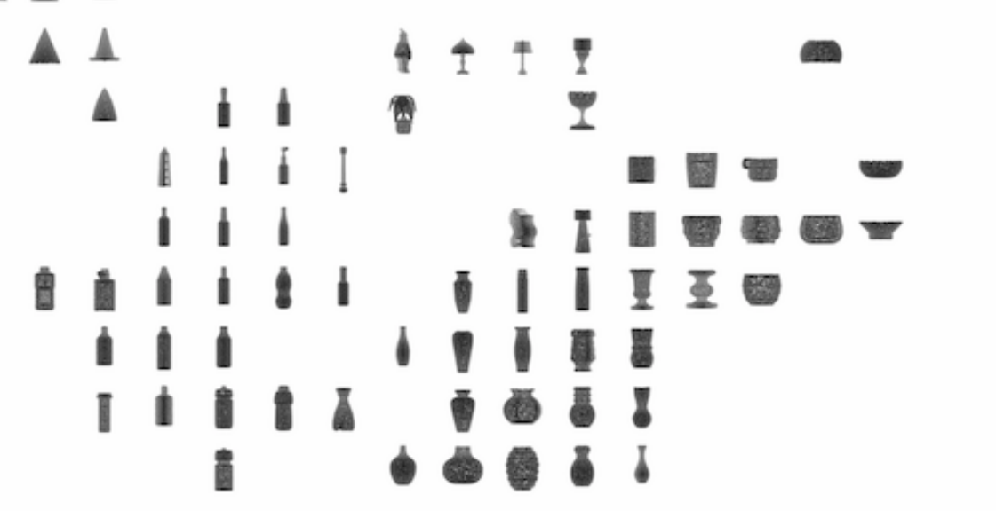
TIMELINE
Work that inspired the paper writers:
Point net(2017)
examples

Slide 19
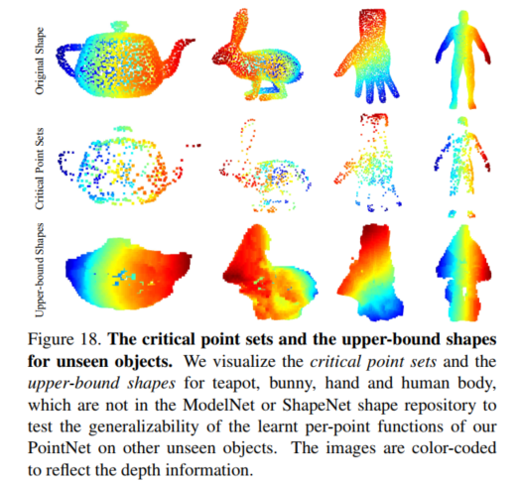
TIMELINE
Work that inspired the paper writers:
Point net(2017)
examples

Slide 20
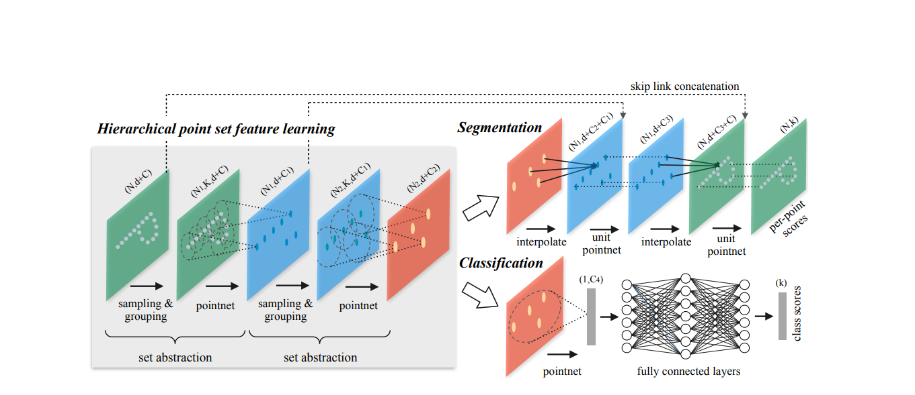
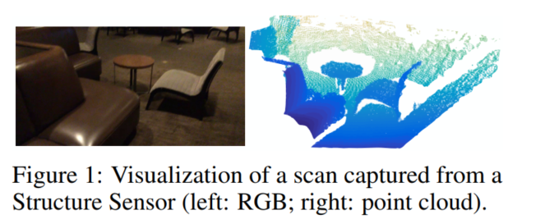
TIMELINE
Work that inspired the paper writers:
Point net ++(2017)
To handle the non uniform point sampling issue, we propose two novel set abstraction layers which aggregate multi-scale information, these contributions enable us to improve accuracy
Notes:
אחד הבעיות של פוינרט נט היא שהיא מתקשה בלשמר אזורים מסויימים כדי לפתור את הבעיה הזאת הם יצרו את פוינט נט ++ (חלק מהנקודות חסרות\בעיות ברזולוציה)
בהתחלה כמו פוינט מתחילים עם נקודות ללא סדר אחרי פעולת ה mlp עי פעולת המקסימום אנחנו מקבלים features
הרעיון של כל המאמר הוא לקבל קונטקסט של ה point cloud
Sampling layer מנסים למצוא מרכזי כובד של אזורים לוקלים בתמונה
Grouping layer מציאת נקודות שכנות ע"י KNN
אחרי כן יש שרשור של point net כדי למצוא מחדש features
Sampling layer FPS
רוצים למצוא תת קבוצה של הקבוצה הגדולה

Slide 21

TIMELINE
Work that inspired the paper writers:
Point net ++(2017)
Iterative FPS
Notes:
אחד הבעיות של פוינרט נט היא שהיא מתקשה בלשמר אזורים מסויימים כדי לפתור את הבעיה הזאת הם יצרו את פוינט נט ++ (חלק מהנקודות חסרות\בעיות ברזולוציה)
בהתחלה כמו פוינט מתחילים עם נקודות ללא סדר אחרי פעולת ה mlp עי פעולת המקסימום אנחנו מקבלים features
הרעיון של כל המאמר הוא לקבל קונטקסט של ה point cloud
Sampling layer מנסים למצוא מרכזי כובד של אזורים לוקלים בתמונה
Grouping layer מציאת נקודות שכנות ע"י KNN
אחרי כן יש שרשור של point net כדי למצוא מחדש features
Sampling layer FPS
רוצים למצוא תת קבוצה של הקבוצה הגדולה

Slide 22
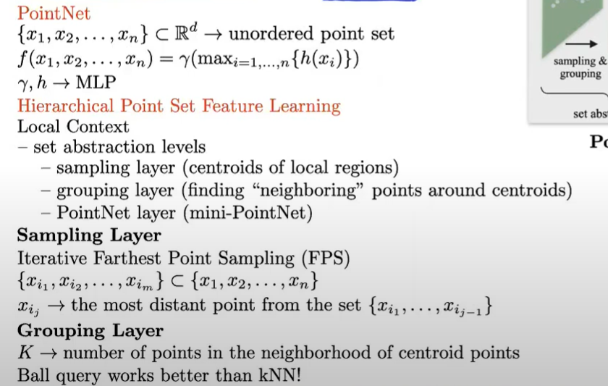
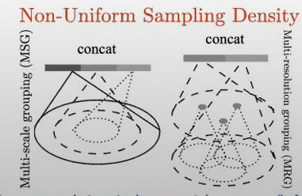
TIMELINE
Work that inspired the paper writers:
Point net ++(2017)
New development
Notes:
אחד הבעיות של פוינרט נט היא שהיא מתקשה בלשמר אזורים מסויימים כדי לפתור את הבעיה הזאת הם יצרו את פוינט נט ++ (חלק מהנקודות חסרות\בעיות ברזולוציה)
בהתחלה כמו פוינט מתחילים עם נקודות ללא סדר אחרי פעולת ה mlp עי פעולת המקסימום אנחנו מקבלים features
הרעיון של כל המאמר הוא לקבל קונטקסט של ה point cloud
Sampling layer מנסים למצוא מרכזי כובד של אזורים לוקלים בתמונה
Grouping layer מציאת נקודות שכנות ע"י KNN
אחרי כן יש שרשור של point net כדי למצוא מחדש features
Sampling layer FPS
רוצים למצוא תת קבוצה של הקבוצה הגדולה

Slide 23
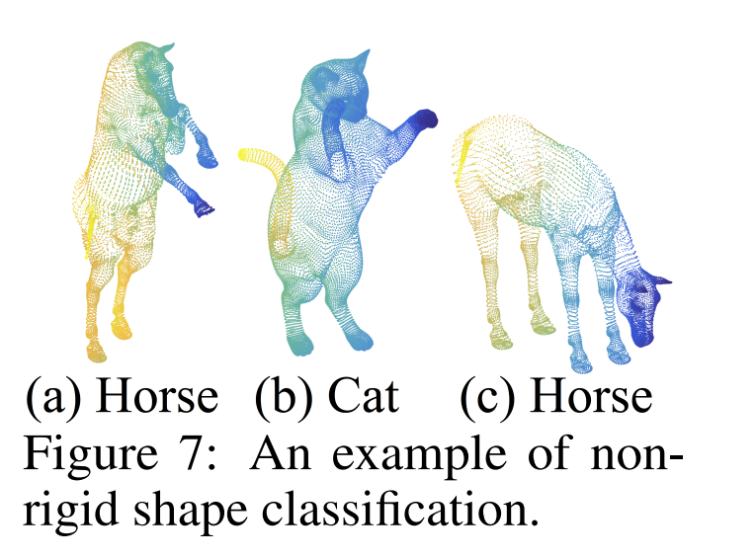
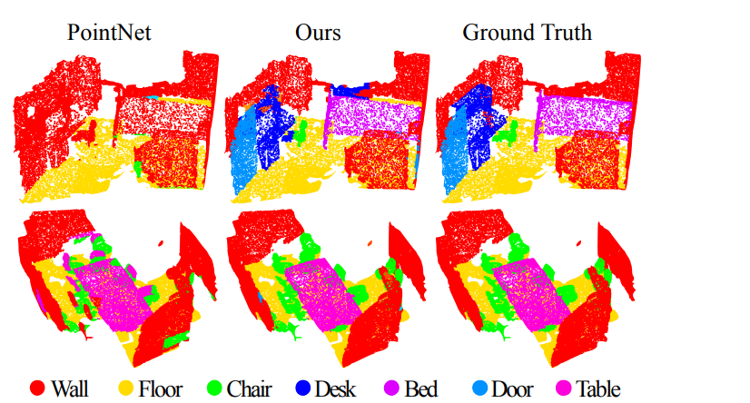
TIMELINE
Point net ++(2017) – visual results

Slide 24
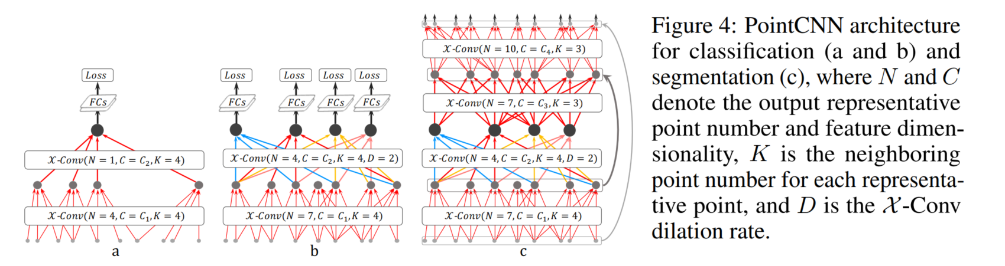
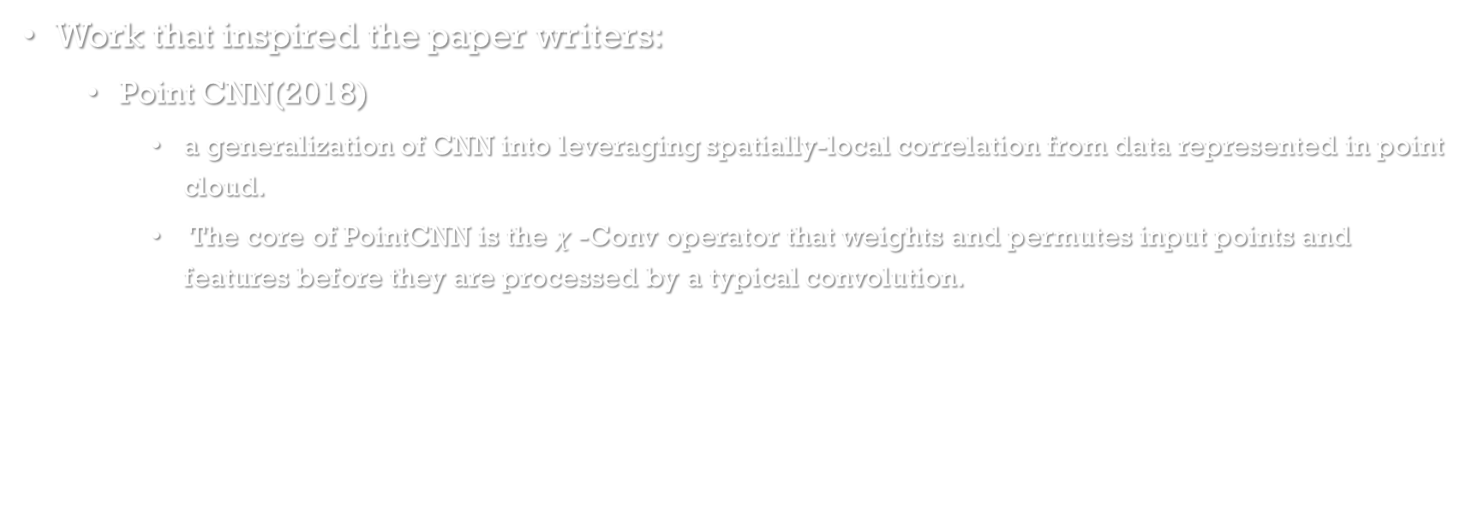
TIMELINE
Work that inspired the paper writers:
Point CNN(2018)
a generalization of CNN into leveraging spatially-local correlation from data represented in point cloud.
The core of PointCNN is the $χ$ -Conv operator that weights and permutes input points and features before they are processed by a typical convolution.

Slide 25
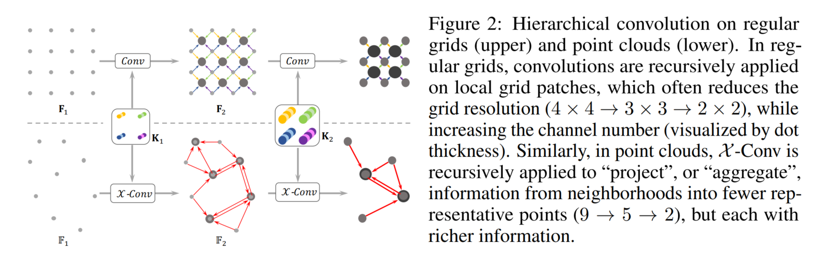
TIMELINE
Work that inspired the paper writers:
Point CNN(2018)
hierarchical convolutions in PointCNN, in analogy to that of image CNNs

Slide 26
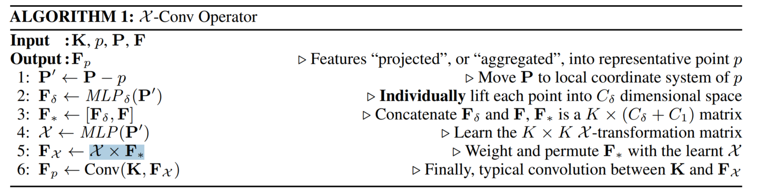
TIMELINE
Work that inspired the paper writers:
Point CNN(2018)
hierarchical convolutions in PointCNN, in analogy to that of image CNNs

Slide 27
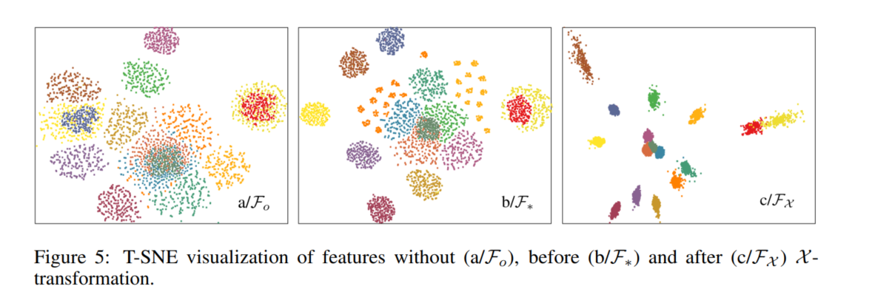
TIMELINE
Work that inspired the paper writers:
Point CNN(2018)

Slide 28
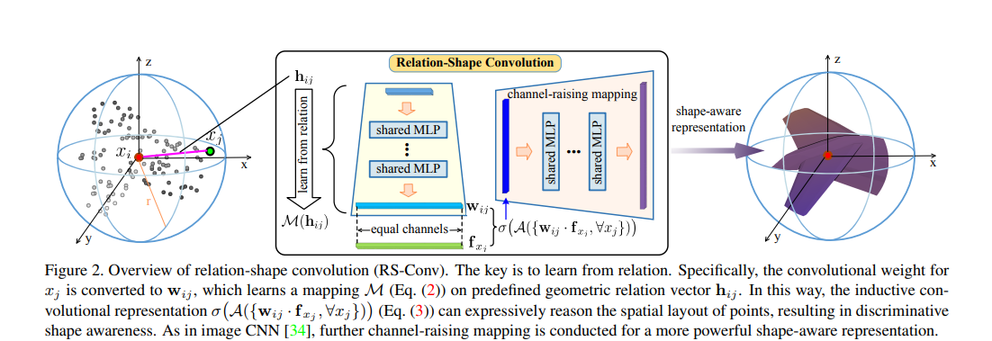
TIMELINE
Work that inspired the paper writers:
Point GMM(2020)
RS-CNN, namely, Relation-Shape Convolutional Neural Network, which extends regular grid CNN to irregular configuration for point cloud analysis
The core to RS-CNN is a novel convolution operator, which learns from relation, the geometric topology constraint among points.
In this way, explicit reasoning about the spatial layout of points can be made to obtain discriminative shape awareness.

Slide 29
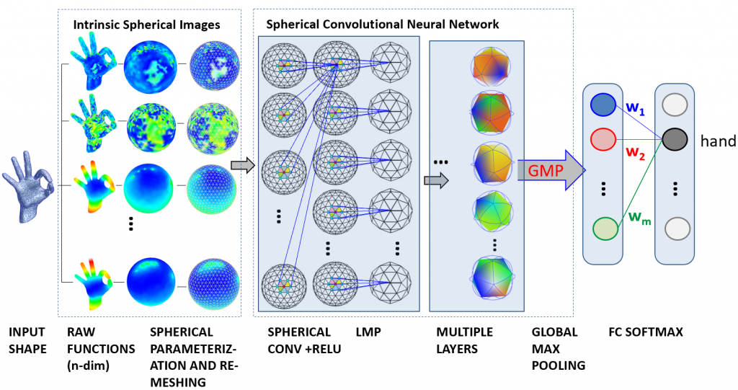
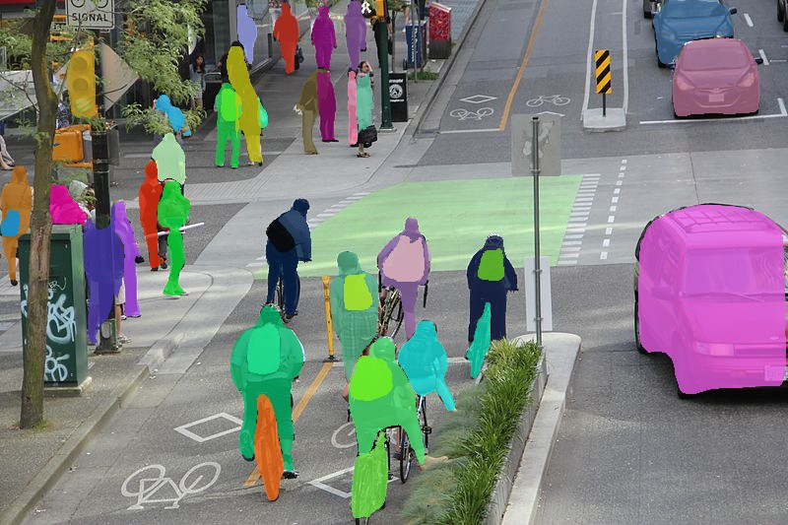
Architecture
Model goals:
shape classification
semantic segmentation

Slide 30
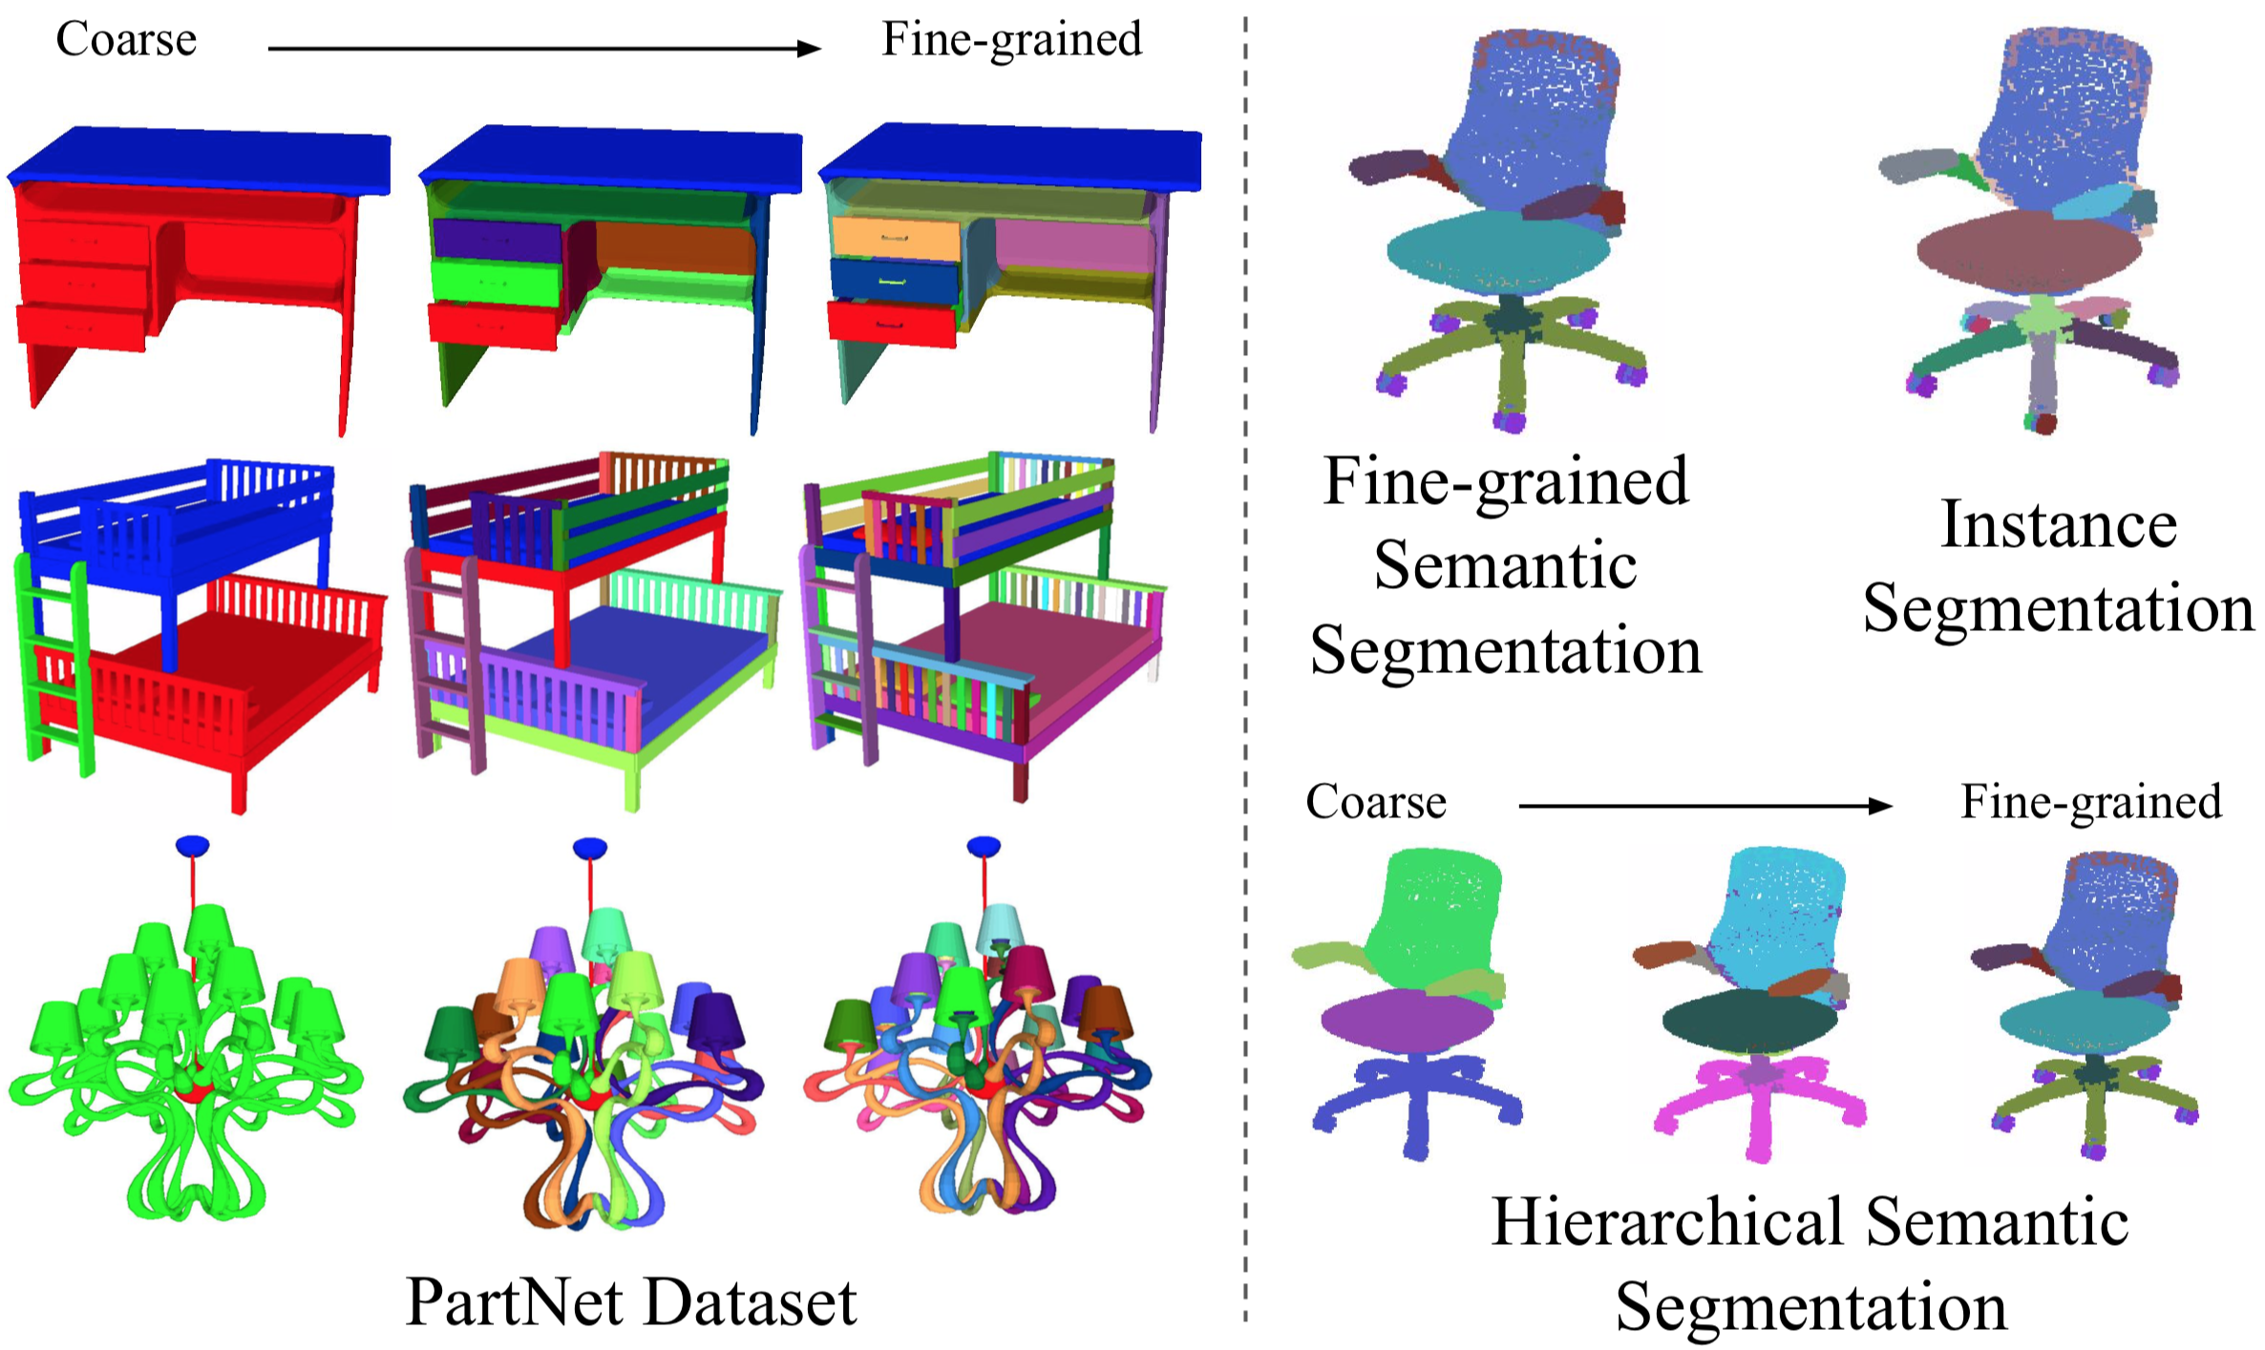
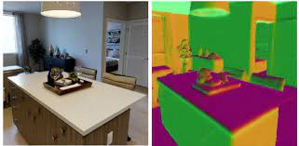
Architecture
Model goals:
part segmentation
normal estimation tasks

Slide 31
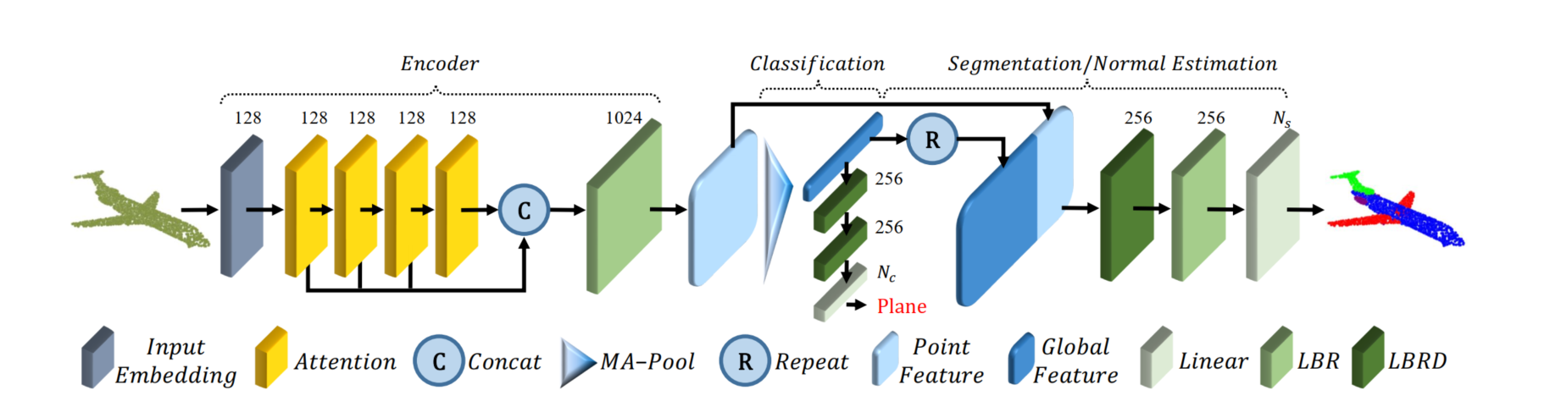
Architecture

Slide 32
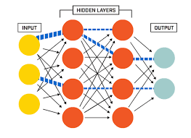
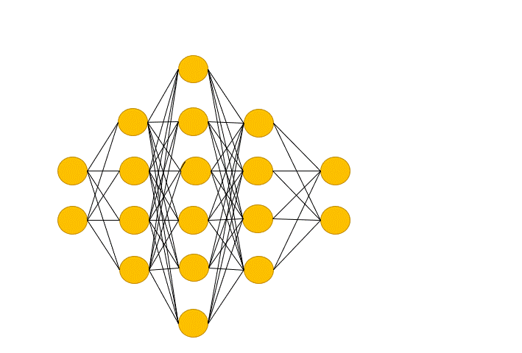
Architecture
Linear -
Drop out -

Slide 33
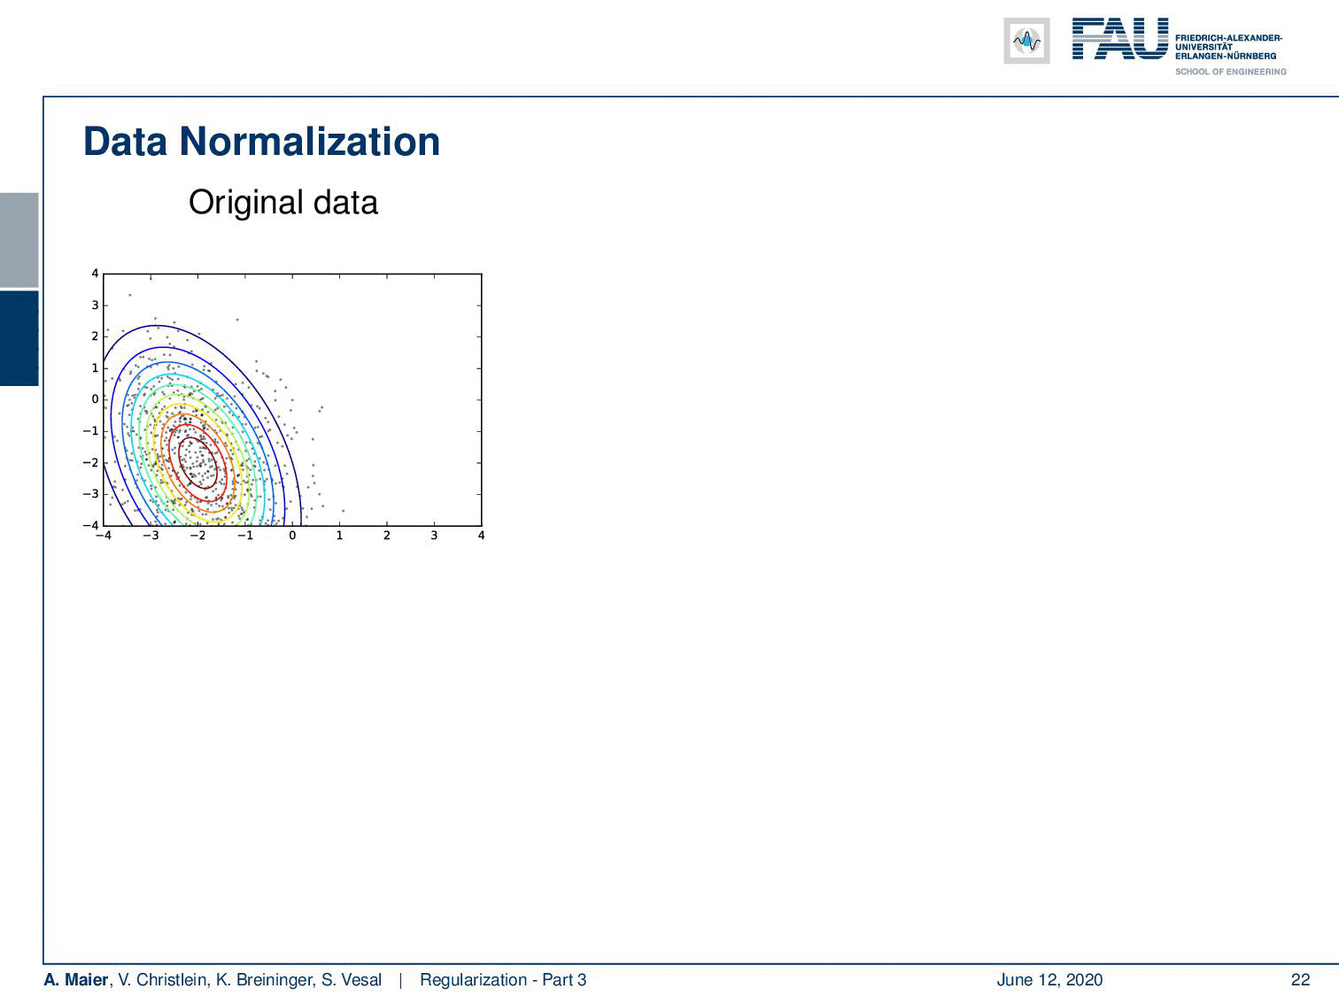
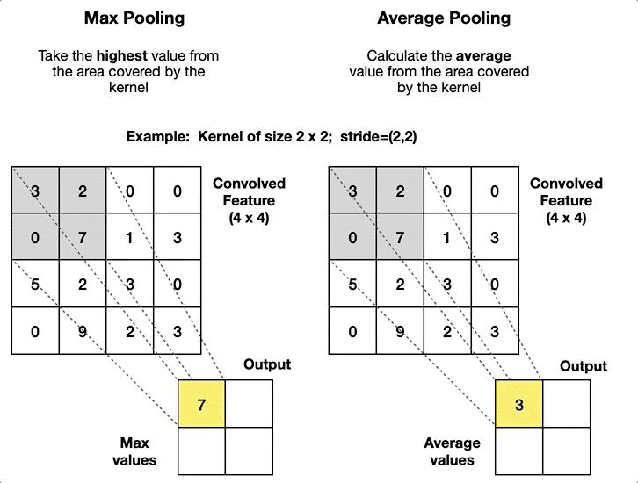
ARCHITHCHER
Batch Normalization -
MA –pooling -

Slide 34
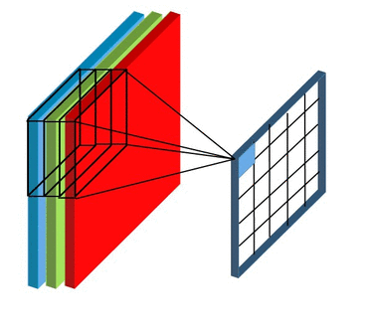
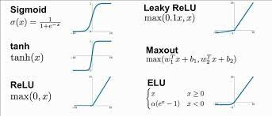
Architecture
Point feature - the results of Volumetric convolution on
on voxels for point feature extraction
ReLU -

Slide 35
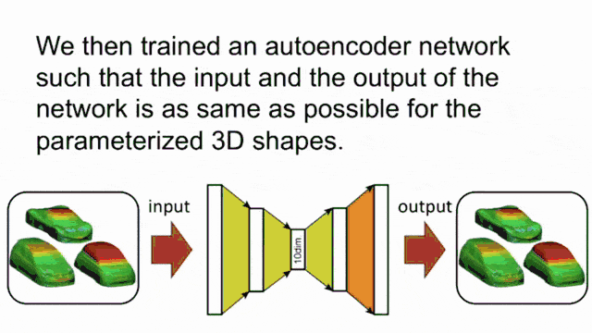

Architecture
LBR - combining Linear & Batch Normalization (BN) & ReLU layers
LBRD – LBR & Dropout
Concat - concatenation of layers\attention output
Repeat - return on same later in order to handle dimensions
Global feature - the results of the average pooling
Input Embedding layer -

Slide 36


Architecture
2 main unique developments :
Offset attention
Neighbor Embedding for Augmented Local Feature Representation

Slide 37

ARCHITHCHER
Offset attention

Slide 38

Architecture
Offset attention
Graph convolution networks show the benefits of using a Laplacian matrix
$$L = D − E$$
a Laplacian matrix replace the adjacency matrix E, where D is the diagonal degree matrix.
network performance improve if applying Transformer to point clouds
replace original self-attention (SA) module with an offset-attention (OA) module to enhance our PCT.
offset-attention layer calculates the offset (difference) between the self-attention (SA) features and the input features by element-wise subtraction.
This offset feeds the LBR network in place of the SA feature used in the naïve version.

Slide 39

Architecture
Offset attention
The traditional Transformer scales the first dimension by $\frac{1}{\sqrt{d_{a}}}$and uses SoftMax to normalize the second dimension.
offset-attention sharpens the attention weights and reduce the influence of noise, which is beneficial for downstream tasks.

Slide 40

Architecture
Offset attention
PCT results:
It can be seen that the attention maps for different query points vary considerably, but are generally semantically meaningful.

Slide 41
Architecture
Neighbor Embedding for Augmented Local Feature Representation
PCT with point embedding is an effective network for extracting global features.
drawback of those architectures is it ignore the local neighborhood information which is also essential in point cloud learning.
Inspired from other work works the paper offer local neighbor aggregation strategy
to optimize the point embedding to augment PCT’s ability of local feature extraction.

Slide 42


Architecture
Neighbor Embedding for Augmented Local Feature Representation
neighbor embedding module comprises two LBR layers and two SG (sampling and grouping) layers, to gradually enlarge the receptive field during feature aggregation, as is done in CNNs.
The SG layer aggregates features from the local neighbors for each point grouped by k-NN search using Euclidean distance during point cloud sampling.
assuming that SG layer takes a point cloud P with N points and corresponding features F as input and outputs a sampled point cloud $P_{s}$with $Ns$ points and its corresponding aggregated features Fs.

Slide 43


Architecture
Neighbor Embedding for Augmented Local Feature Representation
In order to down sample the paper use farthest point sampling (FPS) algorithm
for each sampled point p $∈$Ps, let KNN(p; P) be its k-nearest neighbors in P.
We then compute the output feature Fs as follows
F(p) is the input features of point p
$F_{s}$(p) is the output feature of sampled point p
MP is the max-pooling operator
RP(x; k) is the operator for repeating a vector x, k times to form a matrix.
The idea of concatenating the feature among sampled point and its neighbors.

Slide 44
Architecture

Slide 45





Architecture
PCT encoder math
$W_{0}−$weights of the linear layer
$F_{g}$ - representing the point cloud
$AT^{i}$ - represents the i-th attention layer
$P −$input point cloud with N point each d dimension
$d_{e} −$ $the embedded feature$
$F_{e} −$ first learned via the Input Embedding module
$F_{O} −$ The point-wise feature representation
$d_{o} −dimension of of feature\text{representation}$

Slide 46
ARCHITHCHER
The encoder aims to transform input points into a new higher dimensional feature space
characterize the semantic affinities between points as a basis for various point cloud processing tasks.
The PCT encoder modules :
Embedding the input coordinates into a higher feature space.
The embedded features are later fed into 4 stacked attention module
to learn a semantically rich and discriminative representation for each point followed by a linear layer to generate the output feature.
concatenating the attention output of each attention layer

Slide 47

Architecture
Classification:
To classify a point cloud P into $N_{c}$ object categories (e.g., desk, table, chair)
we feed the global feature $F_{g}$ to the classification decoder:
which comprises two cascaded feed-forward neural networks LBRs
One unit of LBRD with dropout probability of 0.5
finalized by a Linear layer to predict the final classification scores.
The class label of the point cloud is determined as the class with maximal score.

Slide 48

ARCHITHCHER
Segmentation:
The goal is to segment point cloud into $N_{s}$ parts/Class, each point in point cloud needed to be labeled
we first concatenate the global feature $F_{g}$ with the point-wise features in $F_{O}.$
following most other point cloud segmentation networks, the segmentation network decoder is almost the same as that for the classification network, except that dropout is only performed on the first LBR.
Lastly predict the final point-wise segmentation scores $S∈ ℝ^{NXN_{s}}$

Slide 49

Experiments
We now evaluate the performance PCT for each task with different data sets:
Classification - ModelNet40 - https://modelnet.cs.princeton.edu/
Normal estimation - ModelNet40 - https://modelnet.cs.princeton.edu/
contains 12,311 CAD models in 40 object categories

Slide 50

Experiments
We now evaluate the performance PCT for each task with different data sets:
Segmentation - ShapeNet - https://shapenet.org/
contains 16,880 3D models
16 object categories and 50-part labels; each instance contains no fewer than two parts

Slide 51

Experiments
We now evaluate the performance PCT for each task with different data sets:
Semantic segmentation - S3DIS - https://paperswithcode.com/dataset/s3dis
It contains 6 areas and 271 rooms, each point in the dataset is divided into 13 categories

Slide 52
Experiments
Classification
split with 9,843 objects for training and 2,468 for evaluation.
The same sampling strategy as used in PointNet was adopted to uniformly sample each object to 1,024 points.
During training, a random translation in [-0:2; 0:2], a random anisotropic scaling in [0:67; 1:5] and a random input dropout were applied to augment the input data.
During testing, no data augmentation or voting methods were used.
For all the three models, the mini-batch sizes were 32, 250 training epochs were used and the initial learning rates were 0.01, with a cosine annealing schedule to adjust the learning rate at every epoch.

Slide 53

Experiments
Classification
Experimental results are shown in Table bellow
Compared to PointNet and NPCT, SPCT makes a 2.8% and 1.0% improvement, respectively. PCT achieves the best result of 93:2% overall accuracy.
Note that our network currently does not consider normal as inputs which could in principle further improve network performance

Slide 54
Experiments
Normal estimation
The surface normal estimation is to determine the normal direction at each point.
Estimating surface normal has wide applications in e.g., rendering.
The task is challenging because it requires the approach to understand the shapes completely for dense regression.
used average cosine distance to measure the difference between ground truth and predicted normal.
For all the three models, a batch size of 32, 200 training epochs were used.
The initial learning rates were also set as 0.01, with a cosine annealing schedule used to adjust learning rate every epoch.

Slide 55

Experiments
Normal estimation
As indicated in Table bellow
Improvement compared with PointNet , PCT achieves the lowest average cosine distance

Slide 56
Experiments
Segmentation task
Point cloud segmentation is a challenging task which aims to divide a 3D model into multiple meaningful parts.
training & testing split to 14,006 to 2,874
All models were down sampled to 2,048 points, retaining pointwise part annotation.
During training, random translation in [-0:2; 0:2], and random anisotropic scaling in [0:67; 1:5] were applied to augment the input data.
During testing, we used a multi-scale testing strategy, where the scales are set in [0:7; 1:4] with a step of 0:1.
For all the three models, the batch size, training epochs and the learning rates were set the same as the training of normal estimation task

Slide 57

Experiments
Segmentation task
The evaluation metric used is part-average Intersection-overUnion
The results show that our SPCT makes an improvement of 2.1 % and 0.6% over PointNet and NPCT, respectively.
PCT achieves the best results with 86.4%-part average Intersection-over-Union.

Slide 58

Experiments
Segmentation task
Figure bellow shows further segmentation examples provided by PointNet, NPCT, SPCT and PCT.

Slide 59

Experiments
Semantic segmentation task
For fair comparison, we use the same data processing method same as PointNet
Table bellow shows that our PCT achieves superior performance compared to the previous methods

Slide 60

Experiments
Computational resources requirements:

Slide 61
CONCULISION
this paper propose a permutation-invariant point cloud transformer
suitable for learning on unstructured point clouds with irregular domain.
proposed offset-attention and normalization mechanisms help to make our PCT effective.
Experiments show that PCT has good semantic feature learning capability, and achieves state-of-the-art performance on several tasks
Particularly shape classification
part segmentation
normal estimation.

Slide 62
CONCULISION
Transformer has already revealed powerful capabilities given large amounts of training data.
At present, the available point cloud datasets are very limited compared to image.
In future, we will train it on larger datasets and study its advantages and disadvantages with respect to other popular frameworks.

Slide 63


